Slide 1


BOOTSTRAP
With EDUAID
Aatazaz Hussain
23-arid-771

Slide 2
Table of contents
01
03
02
04
Introduction
Breakpoints
Introduction , history , linking and file structure in Bootstrap
Screen size and media Demensions
Components
Layout
Navbar , carousels , cards , dropdowns , buttons , popover , paginations , modals
Grid layout and Gutter classes

Slide 3
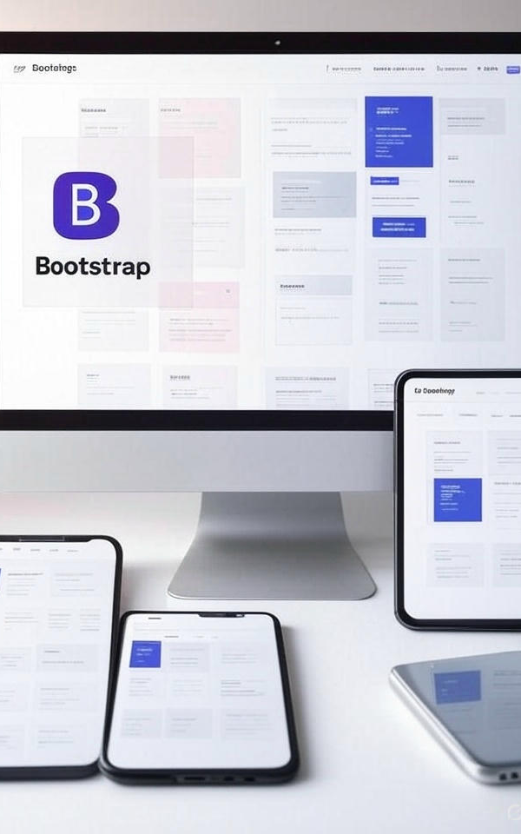
Introduction
Bootstrap is a free and open-source front-end framework aimed at responsive, mobile-first web development. It provides a collection of HTML, CSS, and JavaScript-based design templates and components for typography, forms, buttons, navigation, and other interface elements to help developers build consistent and visually appealing websites quickly. Bootstrap’s core features include a responsive grid system, prebuilt components, and utility classes that simplify layout and styling across different screen sizes and browsers

Slide 4
Key Features of Bootstrap
Responsive Design
Mobile-First Approach
Prebuilt Components
Customizable Themes
Grid System
Cross-Browser Compatibility
Extensive Documentation
Open Source

Slide 5
History of Bootstrap
Bootstrap was developed by Mark Otto and Jacob Thornton at Twitter and released as an open-source project in August 2011. Initially named Twitter Blueprint
Version | Description
Bootstrap 1 | Initial release by Twitter in 2011
Bootstrap 2 | Introduced responsive design (2012)
Bootstrap 3 | Mobile-first and flat design (2013)
Bootstrap 4 | Flexbox-based layout, SASS support (2018)
Bootstrap 5 | Dropped jQuery, new components (2021)

Slide 6
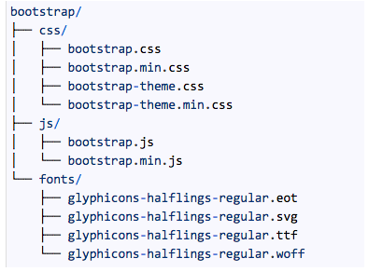
File Structure
File/Folder | Purpose
css/ | Styles folder
bootstrap.css | Full CSS
bootstrap.min.css | Minified CSS
bootstrap-grid.css | Grid only CSS
bootstrap-reboot.css | Normalize styles
js/ | JavaScript folder
bootstrap.bundle.js | JS + Popper
bootstrap.bundle.min.js | Minified JS + Popper
bootstrap.js | JS only
bootstrap.min.js | Minified JS only

Slide 7


01
Bootstrap Linking
CDN Linking and Local Linking

Slide 8
Content Dilvery Network (CDN) Linking
Steps to Link Bootstrap to HTML
When to choose CDN linking
Create a basic HTML file Start with standard HTML structure.
Insert Bootstrap CSS link Add the <link> tag inside the <head> section.
Insert Bootstrap JS bundle Add the <script> tag just before the closing </body> tag.
Save the file Use a .html extension, like index.html.
Open the file in a browser Bootstrap styles and components will now work in your page
When you want quick and easy setup without downloading files.
When your project needs the latest Bootstrap version.
When you have a stable internet connection for hosting access.
When you want faster loading through globally cached resources.

Slide 9
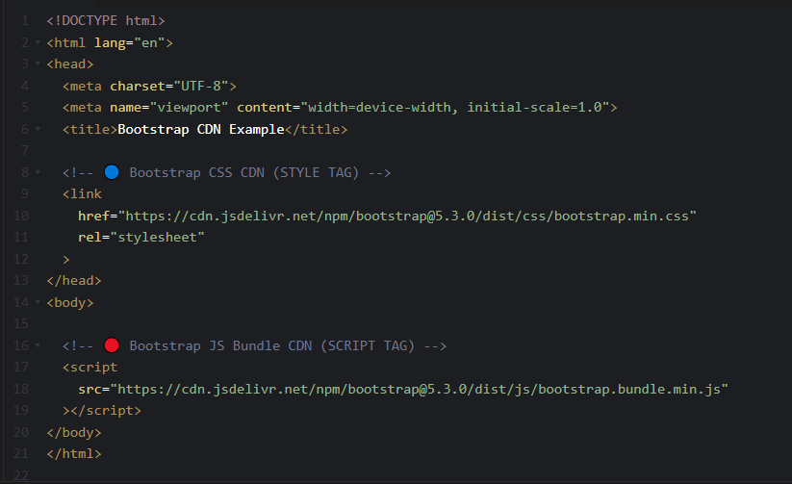
Example Linking

Slide 10
Local Linking
Steps to Link Bootstrap to HTML
When to choose Local linking
Download Bootstrap Go to the official Bootstrap website and download the compiled CSS and JS files.
Create project folders Make folders named css and js inside your project directory.
Place files in folders Move bootstrap.min.css into the css folder and bootstrap.bundle.min.js into the js folder.
Add local links in HTML Use the <link> tag in the <head> to link css/bootstrap.min.css and <script> tag before </body> to link js/bootstrap.bundle.min.js.
Save and open your HTML file Your page will now use the locally stored Bootstrap files.
When working offline without internet access.
When customizing Bootstrap files directly.
When you want full control over file versions.
When hosting on a private or restricted network.

Slide 11
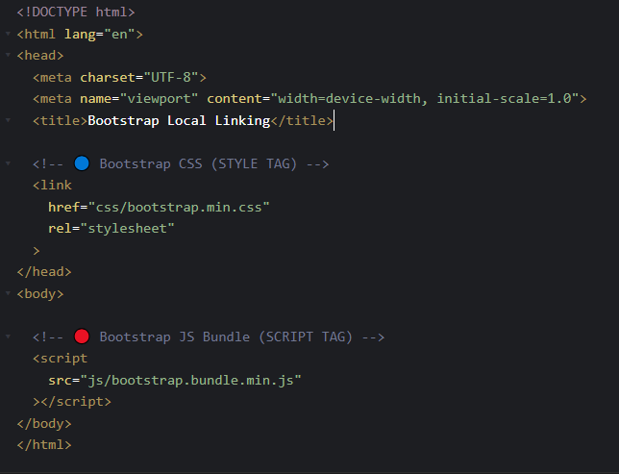
Example Linking
Make sure you've downloaded Bootstrap files and placed them in the
correct folders (e.g., css/ and js/).

Slide 12
02
Bootstrap Components
Explaination , Usage and Example

Slide 13
Navbar
What is Navbar ?
Why we use Navbar ?
Easy navigation
Organized layout
Space-saving design
Consistent structure
Quick access
Mobile responsiveness
Branding support
A navbar (navigation bar) is a section at the top or side of a website that contains links to different pages or sections. It helps users easily move around the website. In Bootstrap, it's built with ready-made classes to make it responsive and stylish.

Slide 14
Navbar Classes
Class Name | Description
navbar | Base class to create a responsive navigation bar.
navbar-expand-lg | Expands the navbar on large screens, collapses on smaller ones.
navbar-light | Light text colors for dark or light backgrounds.
navbar-brand | Styles the logo or brand name inside the navbar.
navbar-nav | Groups the navigation links in the collapsible area.
nav-item | Used to define each item (link) in the navbar.
nav-link | Applies Bootstrap styles to the navigation links.

Slide 15
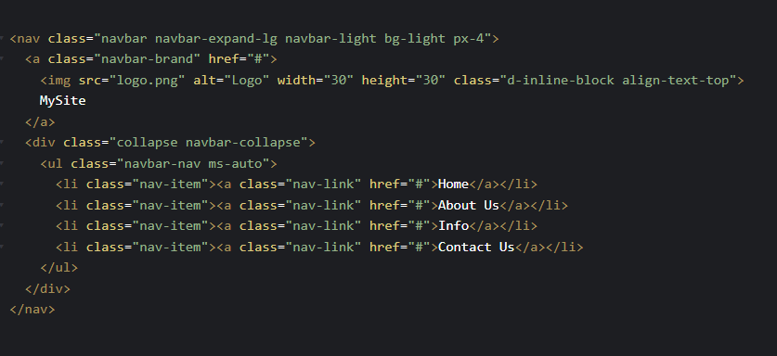
Navbar Example code

Slide 16
Accordion
What is Accordion ?
An accordion in Bootstrap is a component that groups content into expandable and collapsible sections. Each section has a header that you can click to show or hide its content. Accordions help organize long content in a compact, space-saving way
Why we use Accordion ?
Space saving
Clean layout
Easy navigation
Organized content
User-friendly
Interactive UI

Slide 17
Accordion Classes
Class Name | Description
accordion | The main container that wraps all accordion items.
accordion-item | Represents each individual item inside the accordion.
accordion-header | Defines the header section that contains the button.
accordion-button | Styles the clickable button that expands/collapses the content.
accordion-collapse | Controls the visibility of the content section.
accordion-body | Holds the actual content that is shown/hidden when the button is clicked.
collapse | Bootstrap utility class to hide/show collapsible content (used with JavaScript).

Slide 18
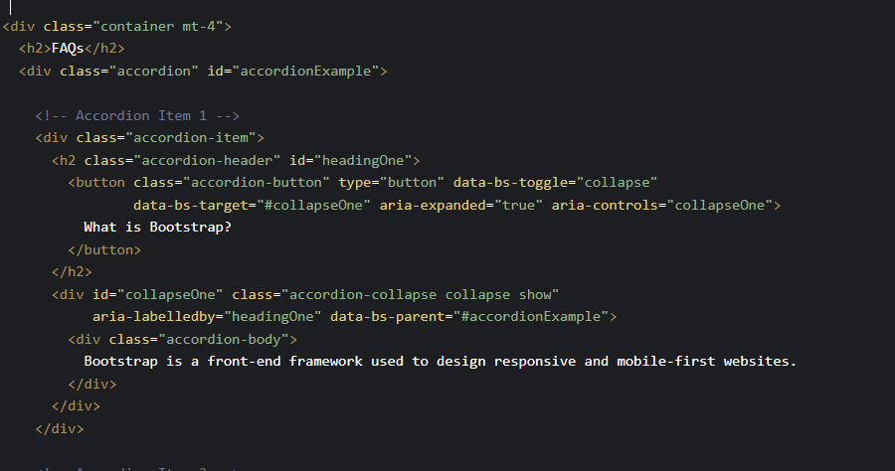
Accordion Example code

Slide 19
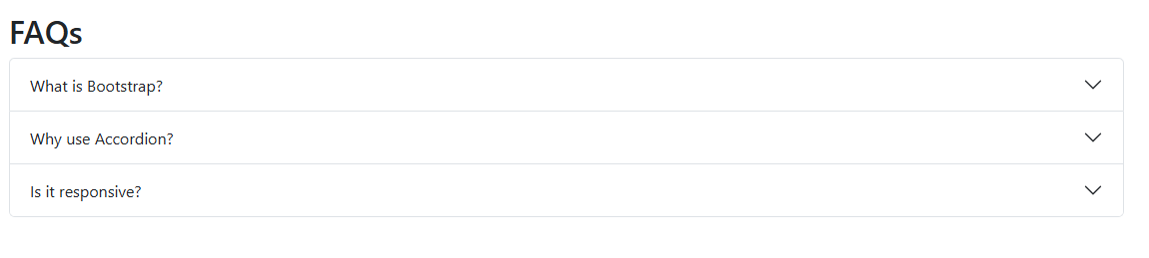
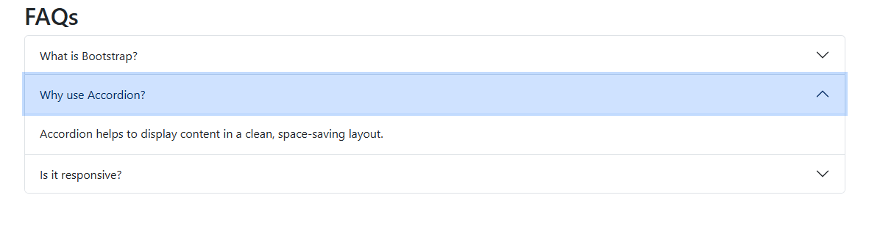
Accordion Example

Slide 20
Alerts
What is Alerts ?
Alerts in Bootstrap are small, colored message boxes used to show important information like success, error, warning, or info messages to users. They help grab attention and quickly communicate feedback or status.
Why we use Alerts ?
Show success
Display errors
Give warnings
Share info
Quick feedback
Easy dismissal

Slide 21
Alerts Classes
Alert Class | Use Case Description
alert-primary | Used for general information or primary messages.
alert-secondary | Used for neutral or secondary contextual messages.
alert-success | Indicates a successful or positive action/message.
alert-danger | Indicates a dangerous or error message.
alert-warning | Used for warnings that need user attention.
alert-info | Used for informational messages that are neutral.
alert-light | Used for light background alerts with subtle info.
alert-dark | Used for dark background alerts for emphasis.

Slide 22
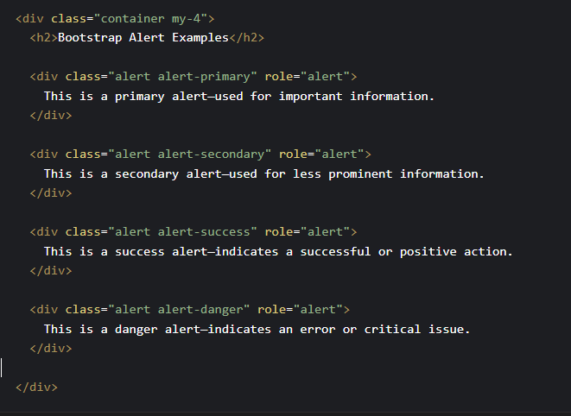
Alerts Example code

Slide 23
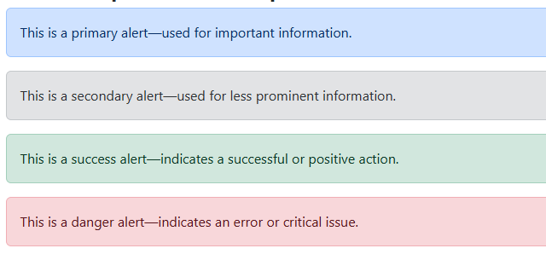
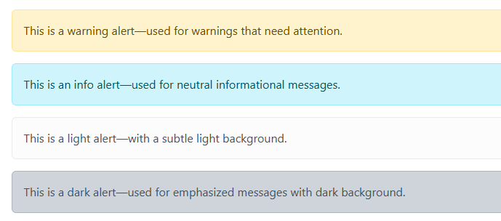
Alert Example

Slide 24
Buttons
What is Buttons ?
In Bootstrap, a button is a styled HTML element (<button> or <a> or <input>) that performs actions like submitting a form, triggering modals, or navigating pages. Bootstrap provides ready-made classes to make buttons look professional and responsive with minimal effort.
Why we use Buttons ?
Trigger actions
Consistent styling
Responsive design
JS component support
Reusable styles
Better UX

Slide 25
Buttons Classes
Button Class | Use Case
btn | Base class for all Bootstrap buttons.
btn-primary | Highlights the main action (blue).
btn-secondary | For secondary or less important actions.
btn-success | Indicates success or positive action.
btn-danger | Represents errors or destructive actions.
btn-warning | Used for warning or attention-needed actions.
btn-info | For neutral or informational actions.
btn-light | Subtle, light-background button.
btn-dark | High-contrast, dark-themed button.

Slide 26
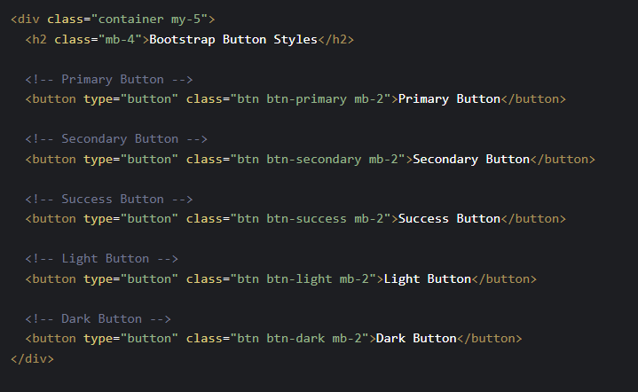
Buttons Example code

Slide 27

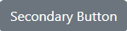
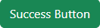
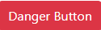
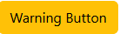
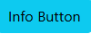
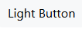
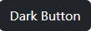
Buttons Example

Slide 28
Cards
What is Cards ?
In Bootstrap, cards are flexible and responsive content containers used to display text, images, links, and more in a structured and visually appealing format. They help organize content cleanly with ready-made styles.
Why we use Cards ?
Content container
Show images
Text + media
Reusable layout
Clean styling
Responsive design

Slide 29
Cards Classes
Card Class | Description
card | Main container for the card.
card-body | Holds the main content inside the card.
card-title | Defines the card's title with proper spacing.
card-text | Regular paragraph text within the card body.
card-img-top | Displays an image at the top of the card.
card-footer | Optional footer area (e.g., buttons, info).
card-header | Optional header area for titles or labels.

Slide 30
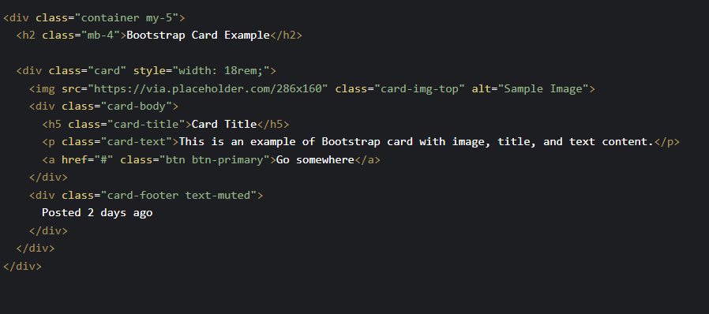
Cards Example code

Slide 31
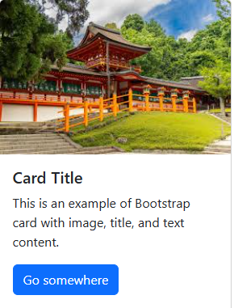
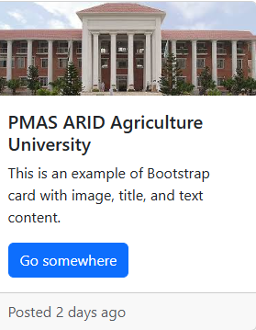
Cards Example

Slide 32
Carousel
What is Carousel ?
A carousel in Bootstrap is a slideshow component used to cycle through images, text, or custom content, allowing smooth transitions and controls like next/previous arrows and indicators.
Why we use Carousel ?
Image slider
Show highlights
Interactive UI
Auto rotation
Responsive layout
Stylish display

Slide 33
Carousel Classes
Carousel Class | Description
carousel | Main wrapper to activate the carousel component.
carousel-inner | Holds all slide items.
carousel-item | Defines each individual slide.
active | Applied to the first (or currently visible) slide.
carousel-control-prev | Left navigation control (previous slide).
carousel-control-next | Right navigation control (next slide).
carousel-indicators | Dots or markers to navigate between slides.
data-bs-ride="carousel" | Enables automatic cycling of slides.

Slide 34
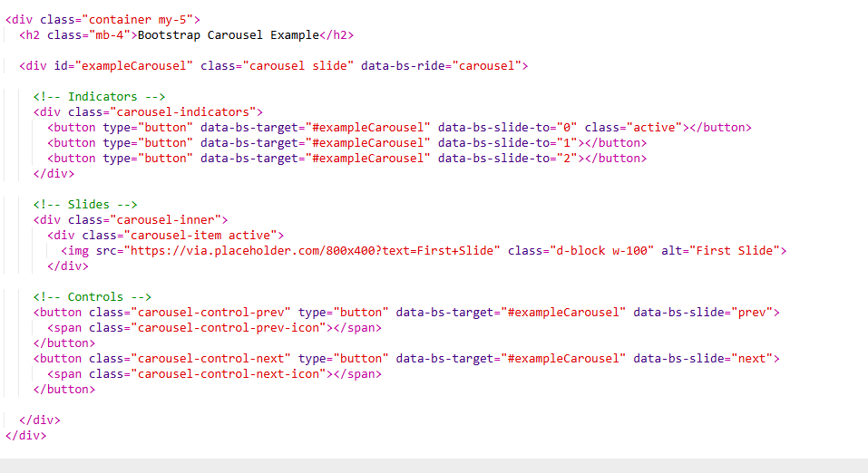
Carousels Example code

Slide 35



Cards Example

Slide 36
Dropdown
What is Dropdown ?
A dropdown in Bootstrap is a toggleable menu that shows a list of links or actions when a user clicks a button. It helps organize options in a compact, interactive format.
Why we use Dropdown ?
Organize options
Navigation tool
Saves space
Quick access
Responsive menu
Grouped actions

Slide 37
Dropdown Classes
Dropdown Class | Description
dropdown | Container that holds the dropdown button and menu.
dropdown-toggle | Applied to the button to enable toggle behavior.
dropdown-menu | Container for the list of dropdown items.
dropdown-item | Individual clickable item in the dropdown menu.
show | Class added dynamically to display the dropdown.
data-bs-toggle="dropdown" | Enables Bootstrap toggle functionality via button click.

Slide 38
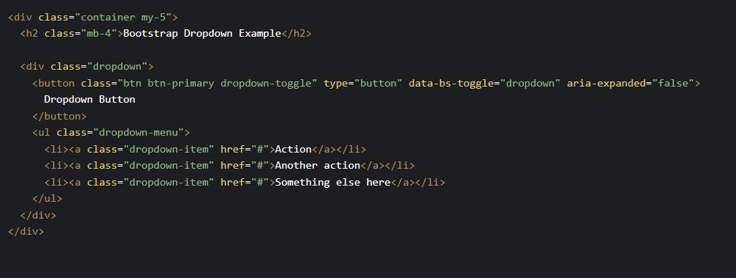
Dropdown Example code

Slide 39

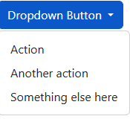
Dropdown Example

Slide 40
Modals
What is Modals ?
A modal in Bootstrap is a popup window that appears on top of the page content to display important messages, forms, confirmations, or other interactions without navigating away.
Why we use Modals ?
Show alerts
Display forms
Login/register
Quick info
Focused interaction
No page reload

Slide 41
Modals Classes
Modal Class | Description
modal | Base class for the modal container.
modal-dialog | Positions and sizes the modal (centered by default).
modal-content | Wrapper for the modal’s actual content.
modal-header | Top section with title and close button.
modal-body | Main content area for text, forms, etc.
modal-footer | Bottom section for buttons/actions.
data-bs-toggle="modal" | Activates the modal on button click.
data-bs-target="#id" | Links button to the modal with a matching ID.

Slide 42
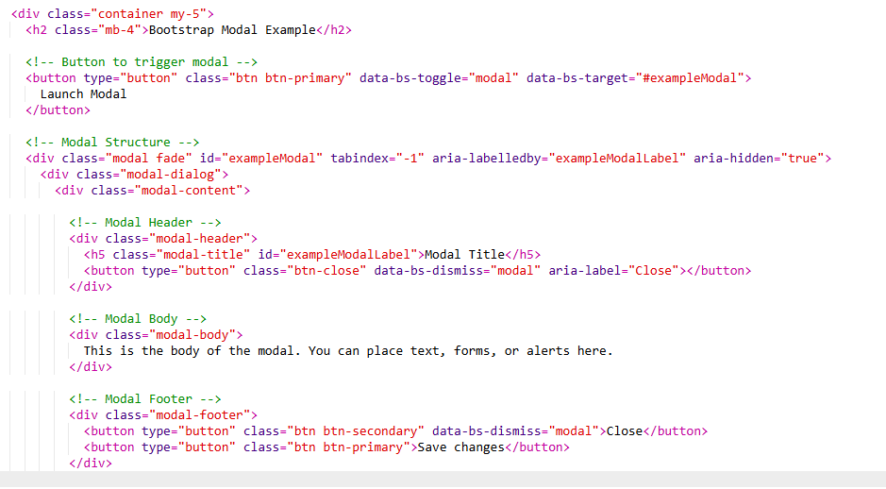
Modals Example code

Slide 43

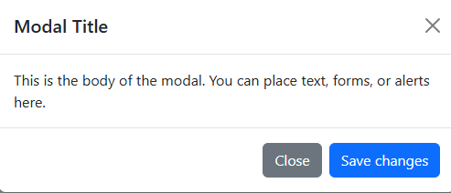
Modals Example

Slide 44
Pagination
What is Pagination ?
Pagination in Bootstrap is used to split content (like posts or records) into multiple pages, helping users navigate easily through sections without overwhelming them with too much data at once.
Why we use Pagination ?
Split content
Easy navigation
Organized layout
Improves speed
Cleaner UI
Responsive pages

Slide 45
Pagination Classes
Pagination Class | Description
pagination | Main container for the pagination component.
page-item | Wraps each page link or number.
page-link | Style for clickable pagination links.
active | Highlights the current active page.
disabled | Disables a page link (e.g., Previous on first page).
justify-content-center | Centers the pagination component (optional utility class).

Slide 46
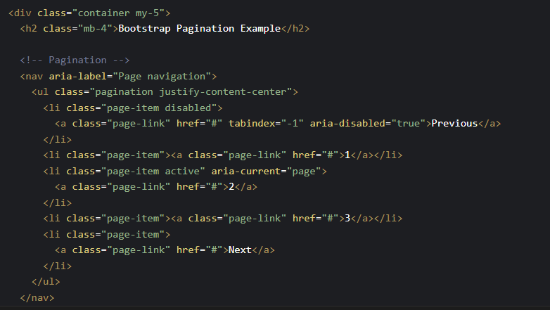
Pagination Example code

Slide 47
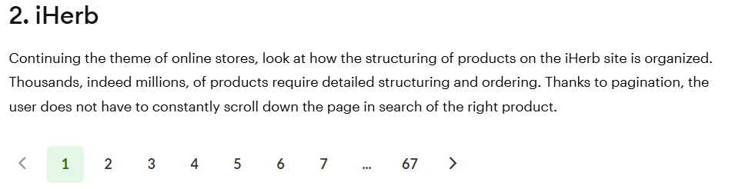
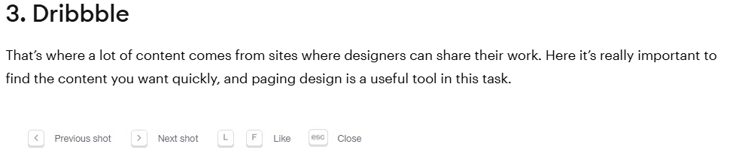
Pagination Example

Slide 48
Popover
What is Popover ?
A popover in Bootstrap is a small overlay that displays additional information when triggered by clicking or hovering over an element. It’s like a tooltip but with more content and structure.
Why we use Popover ?
Extra info
Quick tips
Click or hover
Cleaner UI
Compact detail
Interactive elements

Slide 49
Popover Classes
Popover Class / Attribute | Description
data-bs-toggle="popover" | Enables the popover behavior on an element.
title | Adds a header/title to the popover.
data-bs-content="..." | Defines the body/content of the popover.
data-bs-placement="..." | Controls where the popover appears (top, right, bottom, left).
btn and btn-* | Used to style the trigger button.
data-bs-trigger="hover/click" | Determines how the popover is activated.

Slide 50
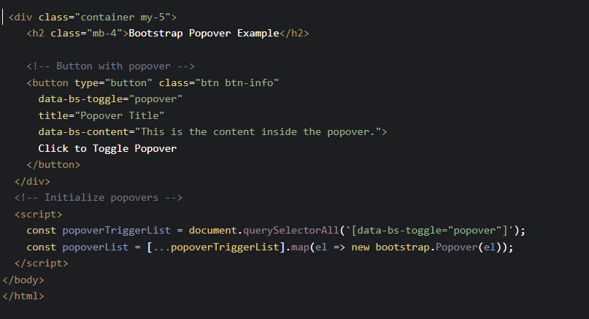
Popover Example code

Slide 51
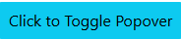
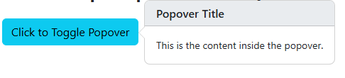
Popover Example

Slide 52
03
Breakpoints

Slide 53
Breakpoints
What is Breakpoint ?
Breakpoints in Bootstrap are specific screen widths where the layout or styles automatically adjust to ensure the website looks good on all devices — from mobile phones to desktops.
Why we use Breakpoint ?
📱 Responsive design
🖥️ Device adaptability
🔄 Auto layout change
💡 Improves usability
🎨 Flexible styling
🧩 Cleaner structure

Slide 54
Breakpoints Classes
Class Example | Meaning
d-none d-sm-block | Hidden on XS, shown on SM and up
col-md-6 | 6-column width on medium and up
text-lg-start | Left-align text on large screens
m-0 m-md-3 | Margin 0 by default, margin 3 on MD and up
btn btn-primary w-100 w-md-auto | Full width on mobile, auto width on MD+

Slide 55
Breakpoints Table
Breakpoint | Prefix | Min Width | Devices
Extra Small | none | <576px | Phones
Small | sm | ≥576px | Portrait tablets, small phones
Medium | md | ≥768px | Tablets
Large | lg | ≥992px | Desktops
Extra Large | xl | ≥1200px | Large desktops
XXL | xxl | ≥1400px | Extra large screens

Slide 56
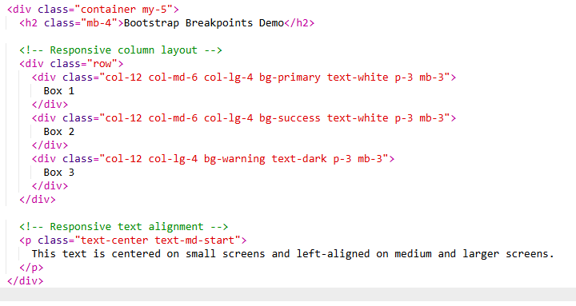
Breakpoints Example code

Slide 57
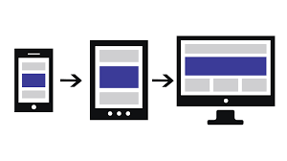
Breakpoints Example

Slide 58
04
Layout
Grid Layout and Gutter classes

Slide 59
A 12-column responsive layout system. Allows creating rows and columns for flexible page design. Works with containers to align and pad content
GRID LAYOUT
Container: Wrapper for content (.container or .container-fluid)
Row: Horizontal group of columns (.row)
Column: Vertical divisions of space (.col, .col-6, .col-md-4, etc.)

Slide 60
GRID Classes
Class | Description
.container | Fixed-width container (responsive)
.container-fluid | Full-width container (100% width)
.row | Wrapper to group columns
.col | Auto-sized column (equal width)
.col-* | Fixed column width (1–12 parts of 12-grid)
.col-sm-* / .col-md-* / .col-lg-* | Responsive columns per screen size
.g-* | Gap utility to add spacing between columns (g-0 to g-5)

Slide 61
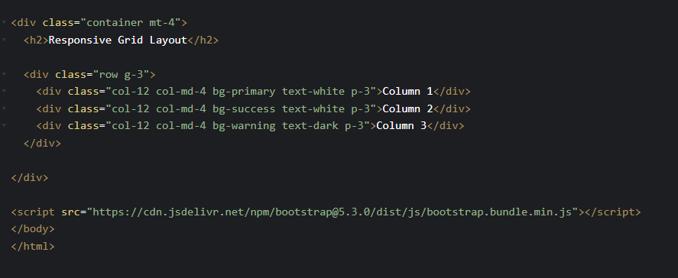
Grid layout Example code

Slide 62
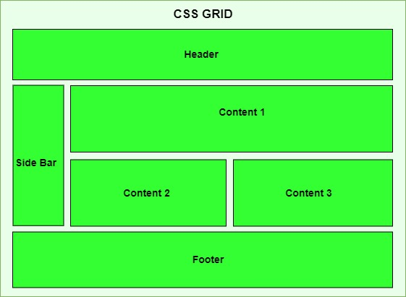
Grid Example

Slide 63
Gutter
What is Gutter ?
Why we use Gutter ?
In Bootstrap, gutters refer to the spacing between columns within a row. By default, Bootstrap applies consistent horizontal spacing, but developers can control both horizontal and vertical gaps using gutter utility classes. These classes allow fine-tuning of layouts by adjusting spacing without the need for custom CSS. Gutter classes are especially useful in responsive designs, ensuring that content remains well-spaced and readable on all devices.
Space control
Grid alignment
Vertical gap
Horizontal gap
Responsive spacing
No custom CSS

Slide 64
Gutter Classes
Class | Description
.g-0 to .g-5 | Sets both horizontal and vertical spacing (0–5)
.gx-0 to .gx-5 | Horizontal gutter only (x-axis)
.gy-0 to .gy-5 | Vertical gutter only (y-axis)

Slide 65
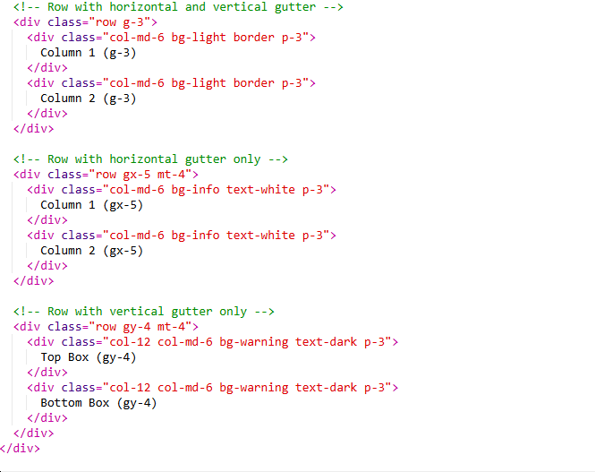
Gutter classes Example code

Slide 66
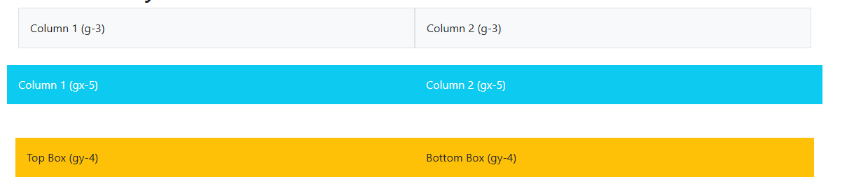
Gutter Example

Slide 67

conclusion

Slide 68
Points to remember while using bootstrap
Use grid system
Keep layout responsive
Use containers
Prefer utility classes
Customize via variables
Use components properly
Follow naming conventions

Slide 69
Points to avoid while using bootstrap
Overusing custom CSS
Ignoring breakpoints
Nesting rows incorrectly
Forgetting container
Mixing fixed/fluid layouts
Using outdated classes
Ignoring accessibility

Slide 70

Thanks!
Do you have any questions?

